Slide 1
National Network for Oral Health Access Webinar
Facing the Challenges of Oral Health Care for Seniors
Leonard J. Brennan D.M.D.
April 3, 2018

Slide 2
Objectives
Review
Review the Dental Demographics of the Senior Population in the United States
Describe
Describe Current Trends in Oral Health in Older Adults
Describe
Describe Functional Status and Oral Health in Aging
List
List Ten Common Oral Health Concerns of the Elder Population

Slide 3
Myth
“Oral disease is just a part of growing older”.
Dry mouth is a natural part of the aging process. “You just have to learn to live with it”.
“Oral health education is integrated into other Health Disciplines”.
“The oral health care for seniors has steadily improved, similar to children”.
“One of the problems facing residents in care facilities is that staff do not wish to provide oral care for seniors. Only dentists will look into someone’s mouth”!
Myth
Myth
Myth
Myth

Slide 4
Dental Demographics of the Senior Population
The Wave: Population
State of Oral Health in this wave of older Americans
Gap in Dental Utilization between Medicare-enrolled Adults and Adults with private insurance is increasing
Notes:
.

Slide 5
Total number of persons age 65 or older, by age group, 1900 to 2050, in millions

Slide 6
2013 Demographics of Cognition ____________________________________________________________________________
Estimated population of the United States----------------------------------- 318,000,000
Estimated populations over age 65----------------------------------------------41,000,000
Estimated population over 65 with a cognitive impairment------------------16,000,000 ____________________________________________________________________________

Slide 7
Sensory Impairment by Age, USA. 1999-2006
NHANES http://www.cdc.gov/nchs/data/databriefs/db31.pdf

Slide 8
Maine Population Comparison
2003 and 2028 Maine Office of Planning, Maine Population Outlook March 2010 p8
 | 65-69 | 70-74 | 75-79 | 80+
2003 | 51,000 | 45,000 | 39,000 | 53,000
2028 | 102,000 | 90,000 | 68,000 | 77,000

Slide 9
Case Scenario: Francis
Francis is an 81 year old senior from Augusta, Maine. She wishes to have her remaining teeth extracted. She has medicine for arthritis and hypertension that causes very dry mouth and a bad taste. “Might as well get them out while I am still healthy and can afford a denture”. Her husband, Walter, is 30 miles away in Long Term Care.
“You tell me my teeth are healthy, but I just had a $250.00 filling completed! I could not even afford the cleaning.”
“I am embarrassed asking my grandchildren to take me there again…to fix my very unattractive teeth!” It’s a monthly struggle to pay bills.

Slide 10
Frances Access problems
Finances
Perception of need
Transportation
Dental IQ
Cultural Attitudes
Workforce
Fear
Health

Slide 11
Medium per Capita Real Income for the Elderly (65+)
Source Employee Benefit Research Institute 2006

Slide 12
Frances Financial Access
Most seniors do not have dental insurance
70% of seniors have no insurance
Cost of dentistry if usually out of pocket

Slide 13
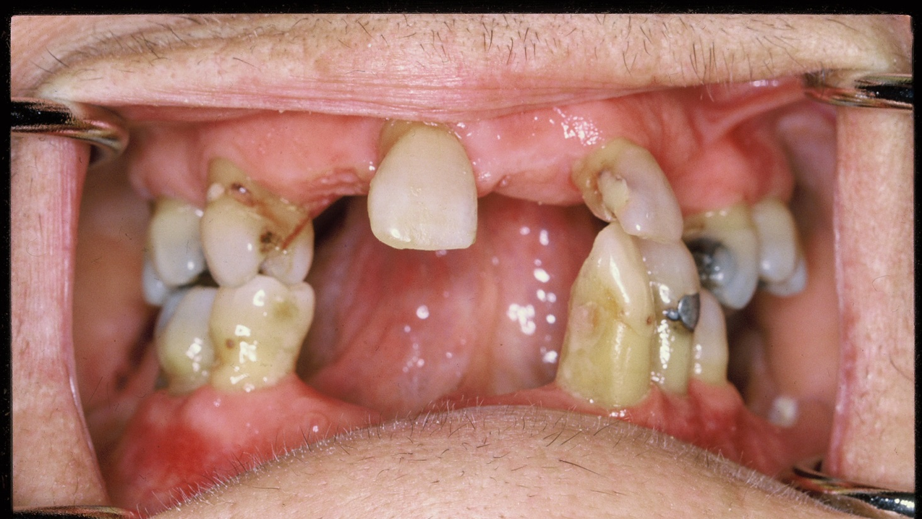
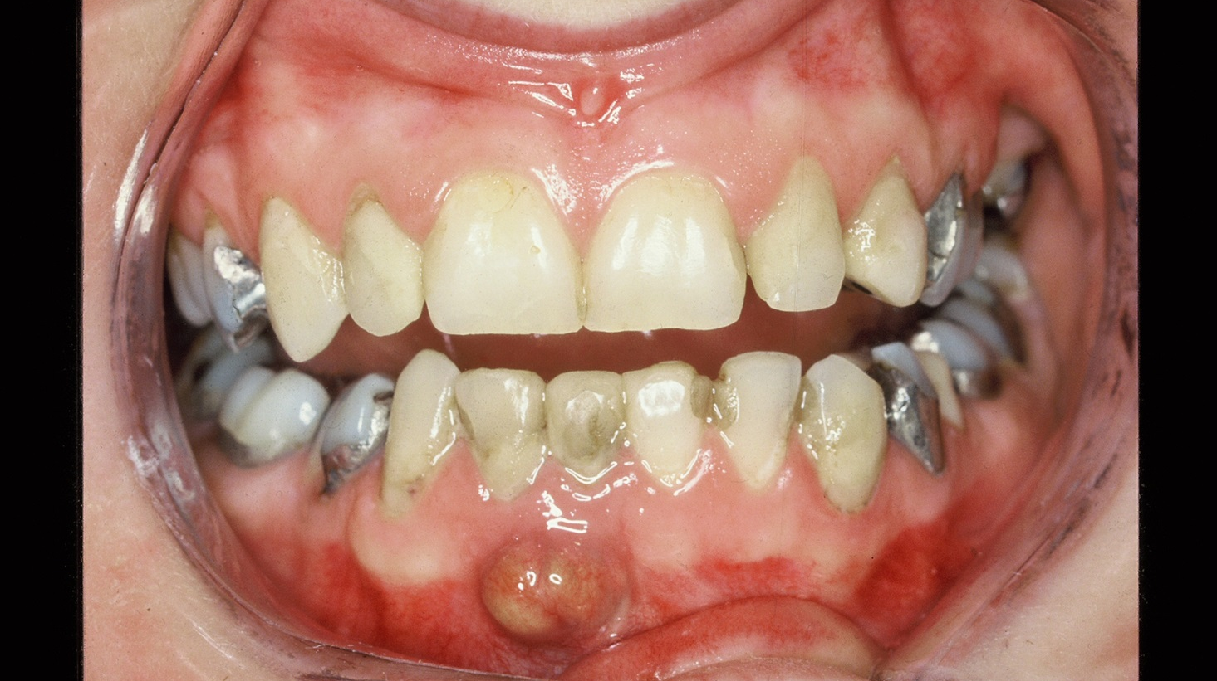
Frances and her husband, Walter
Choices

Slide 14
Costs of Basic Dental Treatment
Survey of ADA 2016
Cleaning---------$125.00
Exams-------------$ 35.00--$125.00
Filling---------------$300.00
Crown-------------$1000.00
Extraction---------$75.00
X-Ray---------------$75.00
Denture------------$ 1000.00

Slide 15
Trends in Dentistry
Recognition of the Importance of Oral Health
Recognition of the Importance of Oral Health
Chronic Diseases Living longer Polypharmacy -Oral Side Effects
“Our System is Stuck” Dr. Marko Vujicic
New models of Care

Slide 16
Marko Vujicic, PHD
The Chief Economist and Vice President, Health Policy Institute, American Dental Association
JADA 149(3) March
Our dental care system is stuck
“We will not see major expansion in dental care use in oral health in the coming years, especially among those with the highest needs”
“Affordability is the greatest reason that senior avoid care”
“The idea that dental care can be stimulate by convincing seniors that is worth it, is in his opinion, a complete fantasy”
“Seniors tend not to perceive the need for care. A team, inter professional approach, is required”

Slide 17

The Long Journey of Integrating Oral Care with Overall Health Care
1988 Surgeon General 1988, Dr. Koop
1. Oral Health is integral to total heath
2. Need a qualified dental work force and support for the education of this work force must continue to come from both public and private sources
3. Need to design and implement curriculum,
4. Need to reduce the wide disparities in oral health status and access to care

Slide 18
Progress and Failure
Significant progress in individual and community oral disease prevention and oral health promotion.
Dentistry has also improved its knowledge of the best ways to prevent and treat oral health problems.
Reduction of disparities has been minimal for the adult population.
Minimal progress in educating non-dental practitioners about the importance of oral health and their role in assuring it improves.

Slide 19
Trend:
Seniors seeking dental care
1970
25% seeking dental care
1985
40% seeking dental care
2000
50% seeking dental care
2010
55% seeking dental care

Slide 20
Trend in Oral Health for Older Adults
Edentulism: Rates have steadily reduced since 1999 50%-32
Caries have increased…More teeth exposed
Incidence of Decay in 2x incidence not institutionalized
Periodontal Disease: 47.2 percent, or 64.7 million American adults, have mild, moderate or severe periodontitis, the more advanced form of periodontal disease, seek treatment

Slide 21
Case Scenario: Pam
Providers’ knowledge and attitudes about aging can affect how accurately distinguish normal changes associated with aging from acute illness and chronic disease.
Ageism can take the form of a provider dismissing Pam’s treatable pathology as a feature of old age, or treating expected changes of aging as though they were diseases…including oral health issue
(Kane, Ouslander, and Abrass, 2004)

Slide 22
Journal of Dental Education
March 1, 2011 vol. 75 no. 3 329-338
Medical School Education
How many hours of material regarding oral health/periodontal health were covered in the curriculum?
≤3 hours 62%
>3 hours to ≤5 hours 23%
>5 hours 15%

Slide 23
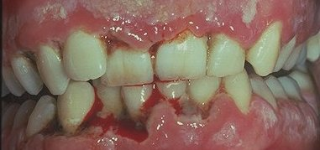
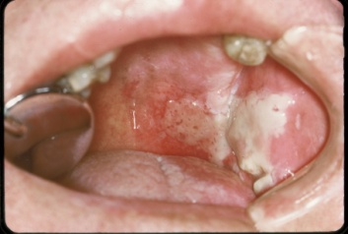
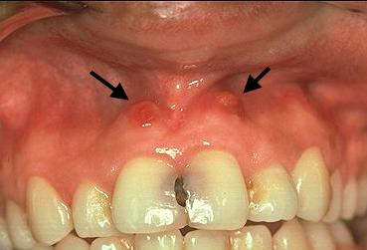
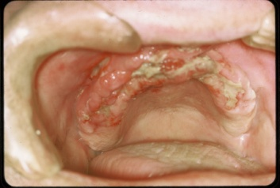
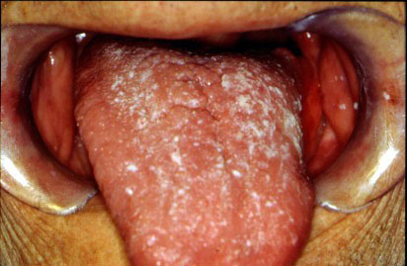
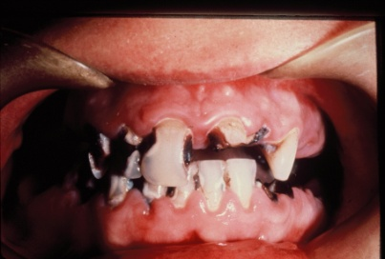
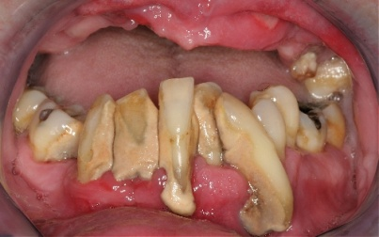

Average Senior Patient Journal of Oral Pathology
1981 Budz, Jorgensen; Encyclopedia on Aging and the Elderly, Roy ,Russell
CDC State of Health in the US
Periodontal
disease 40-75%
Cancer
2%-4%
Denture sores
17%
Assessed teeth
Candidacies
20-44%
Chewing
Problems 75%
Tooth aches 7-10%
Infection
Xerostomia
23%
Decay
75%

Slide 24
Oral Impacts: more common also
(NHANES 2005-2008; Griffin et al., under review)
Greater in LTC

Slide 25
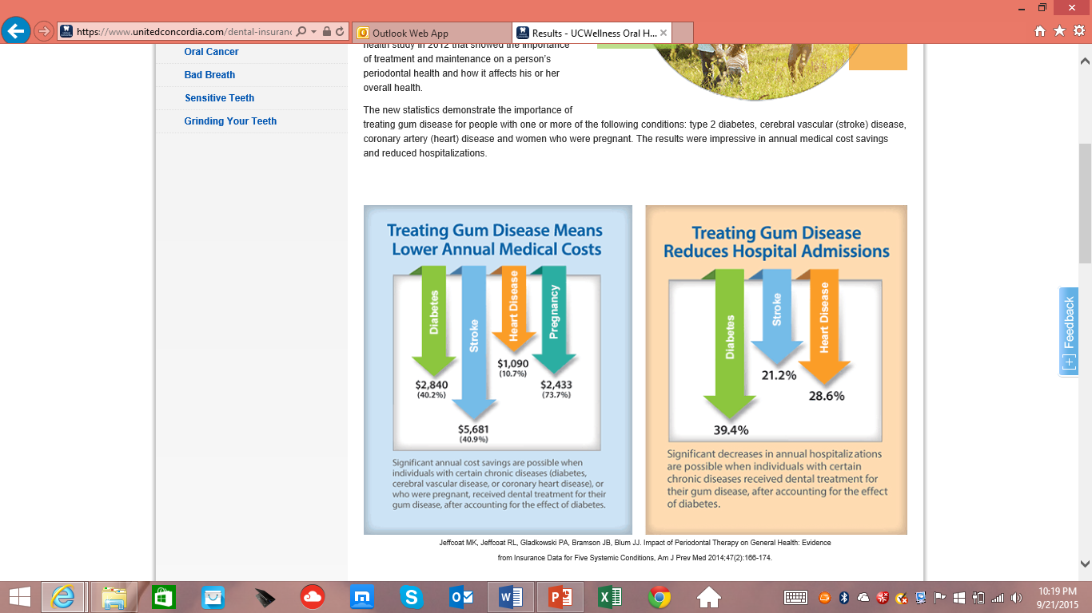
The Importance Dr. Hugh Silk

Slide 26
Trend in Chronic Diseases for Seniors over 65
40+ million) Dr. TillmanTrend
80% have at least one chronic disease
75% have at least 3-4 Chronic Disease
Most Chronic diseases require medication
“Lets talk about these medications”

Slide 27
Chronic Conditions in the USA
NHIS, 2008-2010 Percent with condition

Slide 28
Moist Chronic Diseases are associated with medication
Polypharmacy
Two thirds of seniors take at least one medication
At hospital discharge, they receive 6 or more drugs
In nursing homes, patients often receive 12 to 15 drugs
Side Effects -----Dry mouth and Taste Disturbance

Slide 29
Questions on Saliva
1. Salivary output does not diminish with increasing age.
2. Saliva production is the highest in the afternoon and decreases at night.
3 .There is diminished taste without saliva.
1. TRUE
2. TRUE
3. TRUE

Slide 30
Love the magic of saliva
400 of the most frequently prescribed cause dry mouth
Top 200 cause taste disturbances
Taste
Swallowing
Neutralizes acid

Slide 31
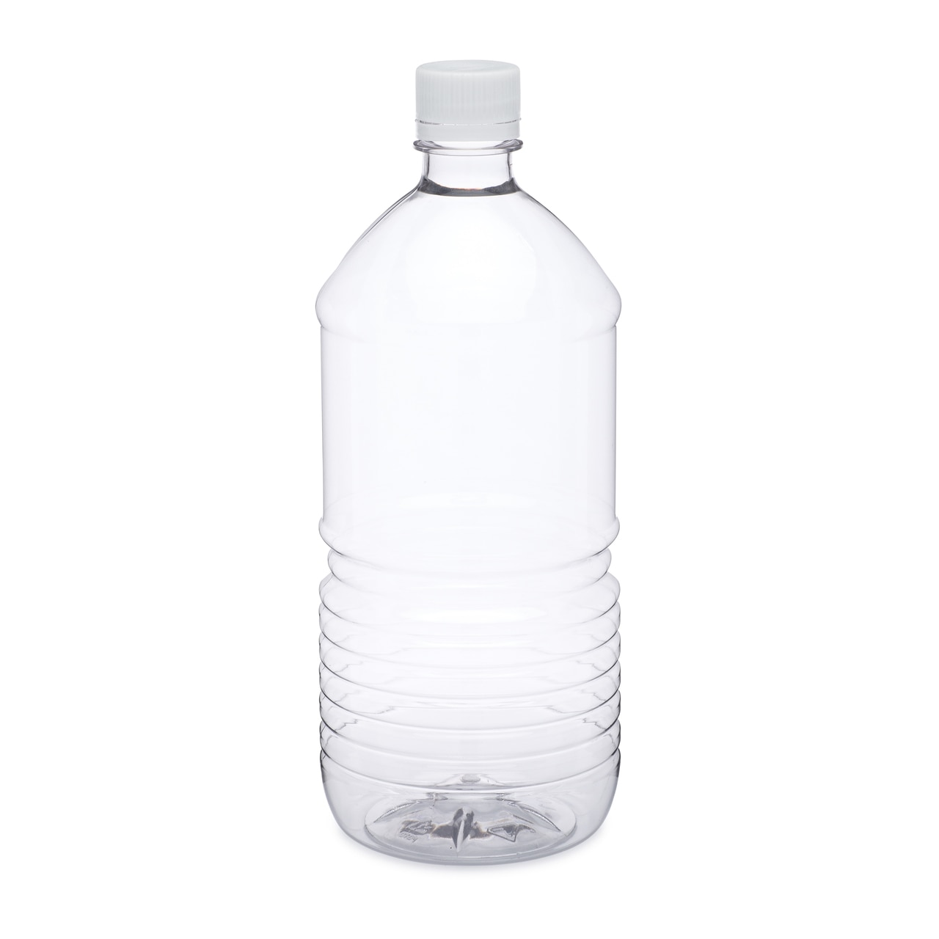
Magic of saliva
Full – normal saliva
1/3 full- medication
1.5 liter
.5 liter

Slide 32
Case Scenario: Mildred
Mrs. Mildred, age 77, has severe arthritis and lives alone. She was always very particular with her oral health routine before bedtime. She cannot afford to visit her dentist.
Her antidepressant medication causes her mouth to be “dried out”.
Her food taste bad and her breath smell very bad. She over heard her grand children saying “Grandma “ugly witch teeth”.
.

Slide 33
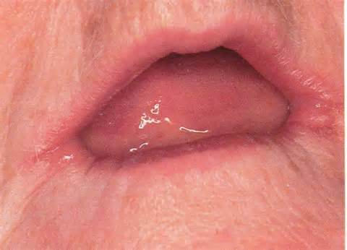
Dry mouth and angular cheiitis
Notes:
.

Slide 34
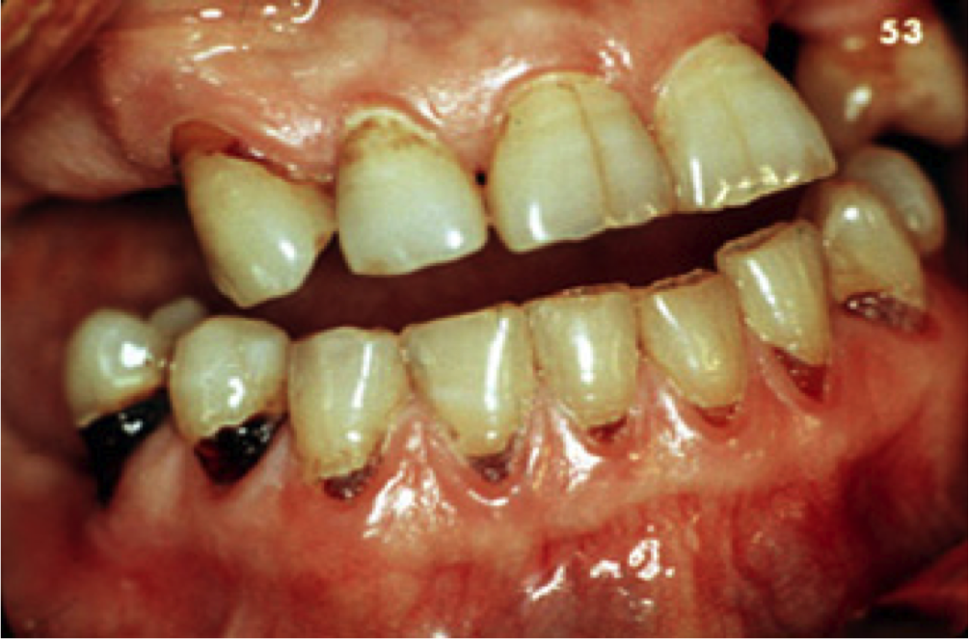
Cervical Caries

Slide 35
Focus on the Future
Innovative Models of Care
Integrated models of Care
Redefining Roles
Use of New Technology
Interdisciplinary Geriatric Care in Action
Advancing a policy agenda to improve the oral health of vulnerable elders

Slide 36
Medical/Dental Integration To Improve Oral Health
Healthy People 2020, The Challenge ; DentaQuest
“Integration of oral health into medical care expands the potential for high-risk individuals to have access to care that halts and even reverses dental disease, avoiding or reducing the need for expensive treatment.”

Slide 37
Collaboration vs. Integration from DentaQuest Dori Bingham
Collaboration = primary care and oral health working with one another
Integration = oral health working within and as part of primary care or vice versa…..Provision of dental services within primary care
Minimize Access to Care Issues

Slide 38
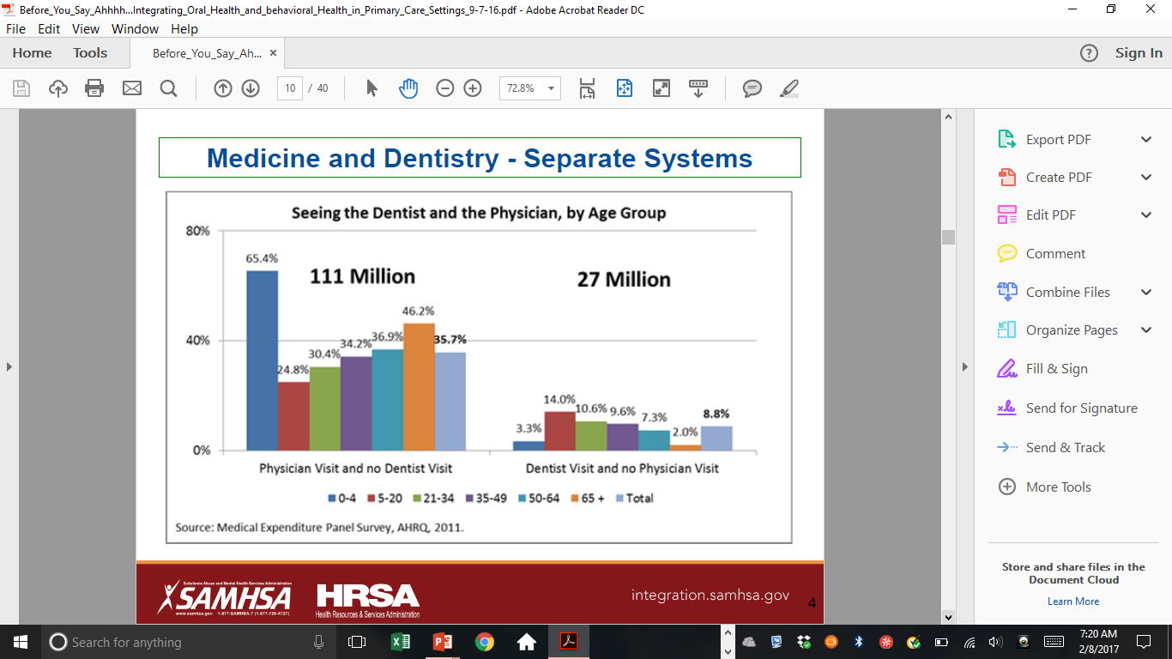
Why should dental address medical issues?

Slide 39

Maximize Places
Dr. Hugh Silk, Rural Health
University of Massachusetts Medical School

Slide 40
Federally Qualified Health Centers
Health centers are community-based and patient-directed organizations that serve populations with limited access to health care
In 2009, there were 1,131 health centers and about 75% of those centers provided on site dental services.

Slide 41
Teledentistry
Dr. Paul Glassman has implemented teledentistry in his home state of California.
It’s similar to visiting a brick and mortar dental office, only the dentist may be on a computer screen instead of in person.
Teledentistry in and of itself is not a service. It’s really a method by which services are delivered.

Slide 42
PACE
Pace is a Medicare and Medicaid Program that helps people meet their needs in the community instead of going to a nursing home or other care facility. Stands for Programs of All Inclusive Care for the Elderly.

Slide 43
Functional Status and Oral Disease
Disabilities and oral health and disease

Slide 44
Picture the Wave
Over 50% of seniors have at least one Physical Disability
*That's over 20 million
Increases with age

Slide 45
Geriatric Dentistry, Aging and Oral Health
Papas, Linda Niessen, Howard Chauncey
An ADL of most concern to the dental team is the ability to eat. If a person can eat, it usually means that the person has sufficient upper arm mobility to perform oral hygiene procedures on a daily basis.
Notes:
.

Slide 46
Clinical Scenario: Rose
Body Image and Social Interaction
Oral Healthcare and the Frail Elder: A Clinical Perspective, 2011
Rose, age 74, has suffered from arthritis for many years and recently had breast cancer. It has been very difficult for her to move her right arm and perform some of her basic living skills. Oral hygiene has been extremely difficult.
Rose has a very dry mouth from her medications. She uses hard lemon candy to help with her dry mouth.
With her poor appearance, discolored, broken teeth, and her “and smelly breath” becoming worse every day, she has stopped all social interaction including seeing family, going to church and all social events. She feels shunned.

Slide 47
Clinical Scenario: Rose, Communication
Rose’s poor appearance and bad breath contribute to her decreased verbal communication through embarrassment and result in non-verbal communication.
Rose and her friends rate a good smile and the ability to chew and eat as one of the most important indicators of their quality of life.
Rose just nods.

Slide 48
Ten Common Oral Concerns for Seniors:
Dental Disease is Not a Normal part of Aging
Oral Health promotes good Body Image and Social Interaction
The Dentist is Not the only healthcare professional willing to help in oral care.
Notes:
.

Slide 49
Ten Common Oral Concerns for Seniors:
Is sugar free candy really better than regular candy”?
Any harm in eating before bedtime?
Will chemotherapy and radiation impact my oral health?
My medications make me so dry that I cannot swallow. What can I do?
Is it OK to suck on a lemon drop when my mouth is dry? It seem to stimulate saliva.
Do saliva substitutes work?
My doctor prescribed medicine to treat a yeast infection in my mouth caused from antibiotics. Any recommendations?
I am a smoker and drink 3 glasses of wine every day. Am I at risk of oral cancer? What does it look like?
Is fluoride still effective in seniors?
Should I buy an electric tooth brush? Are they better than a manual brush?
Are there adaptive dental equipment for people that at have disabilities?

Slide 50
for Seniors:
Additional Concerns for Seniors:
Is too much denture adhesive toxic?”?
What is the best way to clean my denture?
Is it true that I need to clean my denture if I have a yeast infection in my mouth?
Thoughts on Waterpics and electric toothbrushes
.

